Slide 1
TK2100: Informasjonssikkerhet Lesson 03: Operating Systems
Dr. Andrea Arcuri
Westerdals Oslo ACT
University of Luxembourg

Slide 2
Goals
Understand basics of how Operating Systems (OS) work
Understand what OS do to improve the security of their data and operations
Also look into Bash and Docker
as we will need them in the rest of the course… and they are very important even outside of security

Slide 3
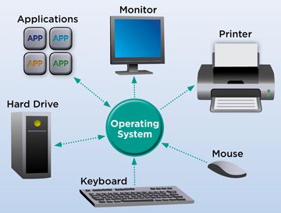
Operating Systems (OS)
“An operating system (OS) is system software that manages computer hardware and software resources and provides common services for computer programs.” (ct. Wikipedia)
Eg: manage applications, handle files on hard-drive, network connections, handle mouse/keyboard inputs, etc.

Slide 4
Main Operating Systems (OS)
Linux (and its variants)
Most common/used OS
Web servers, Internet of Things (IoT) devices, mobiles (Android), etc
Not so user-friendly…
Windows
Main OS for desktops, personal computers
Good for videogames and to spice up your days by crashing and failing in the most surprising ways…
macOS
The power and reliability of Linux for personal desktops, but in a user-friendly way
No/limited videogames
Bloody expensive for personal use… (for employees, it is cost saving…)

Slide 5
What if a hacker has direct physical access to the hardware?
Can just install a new (custom) OS
If direct access to hardware, not so much you can do to protect it, apart from encrypting your hard-drive
So, interested in: if hacker breaks in, how can damage be limited?
Also, how to avoid user screwing up by mistake?

Slide 6
Recall 10 Security Principles
2: Fail-safe defaults
Conservative default settings
3: Complete mediation
Access rules for resource accesses
5: Separation of privilege
Fine-grained access rules, not too general
6: Least privilege
Access only to needed resources
10: Compromise recording
Log what is going on

Slide 7
OS Main Components
“Visible” to the user
Shell and GUI
File-system
Devices, eg printers and webcams
Transparent (under the hood)
CPU administration
Memory (RAM) management
Communication services (e.g., networking)
Application program layer
Operating system layer
User interface
File
Device
(shell)
management
management
Processor
Memory
Communication
(or process)
management
services
management
Hardware layer

Slide 8
Kernel
Core component of the OS
It manages the low level details of the hardware
OS can also provide non-essential software (eg, choice of pretty icons for folders)
When talking of Linux, that is usually just the kernel
https://github.com/torvalds/linux
Linux distributions (Ubuntu, Fedora, etc.) contains the kernel plus all other kinds of software
User Applications
Userland
Non-essential OS Applications
OS
The OS Kernel
CPU, Memory, Input/Output
Hardware

Slide 9
Device Drivers
Applications needs to use hardware
eg, text editor reading keyboard inputs
eg, PDF (Adobe) reader accessing printer when printing a document
Applications do not interact directly with hardware
OS Kernel provide high level API to interact with hardware
API: Application Programming Interface

Slide 10
System Calls
Handling of hardware is critical, which needs its set of permissions and constraints
Device drivers are still software, like the application programs
When application use API of a device driver, OS does what called a system call
The code of the API is the executed in kernel mode, which has a series of limitations for security handled by the OS

Slide 11
System Calls, Cont.
Software interrupts: requests to execute code in kernel mode
Trap: the switching from user mode to kernel mode
application
application
application
USER MODE
KERNEL MODE
system call interface
OS components

Slide 12
Processes and Threads

Slide 13
Processes
A program is a (static) list of instructions that describes how a task should be performed.
Contains and manipulates data
The required resources (memory space, disk space, I/O equipment, priority, privileges...) must be available
When an application is run on a computer, it is called a process
OS assigns a unique ID to each running process

Slide 14
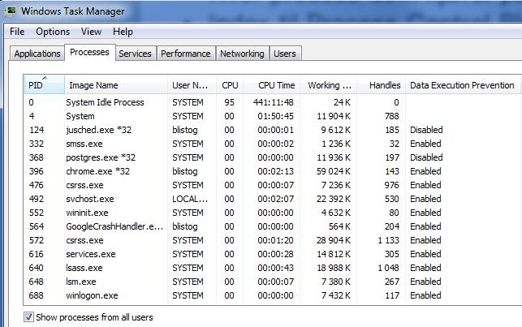
Process Identification: Windows

Slide 15
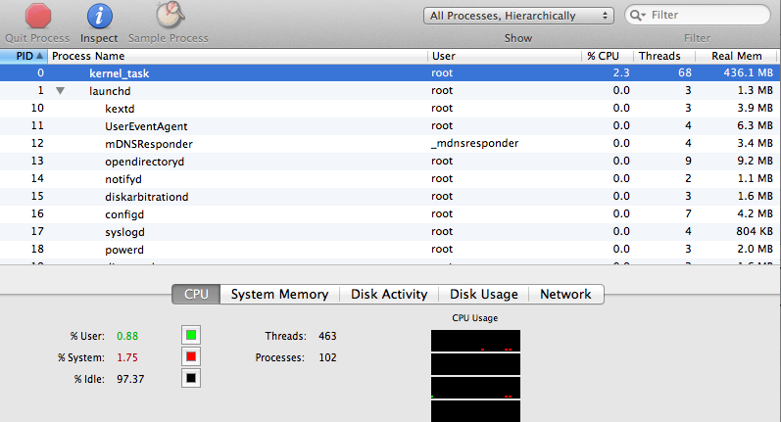
Process Identification: Mac (Activity Monitor)

Slide 16
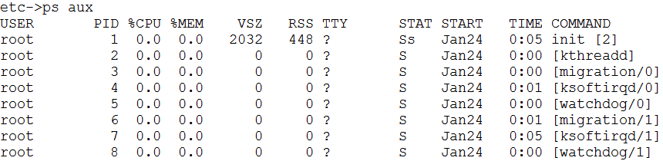
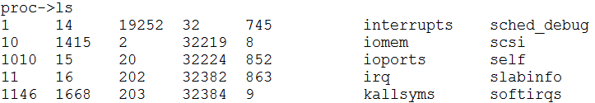
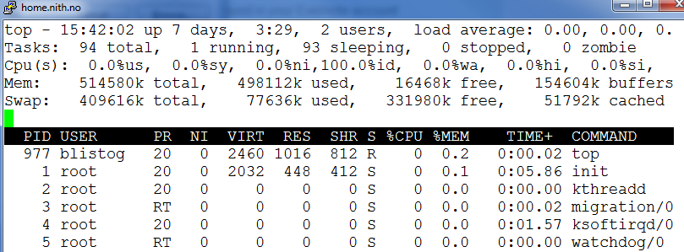
Process Identification: Linux (ps, top, /proc m.fl.)

Slide 17
Daemons and Services
Process run in the background, usually started when OS boots
Important for security, because usually having higher permissions that processes directly started by user
Linux/OSX: Daemon
Windows: Service

Slide 18
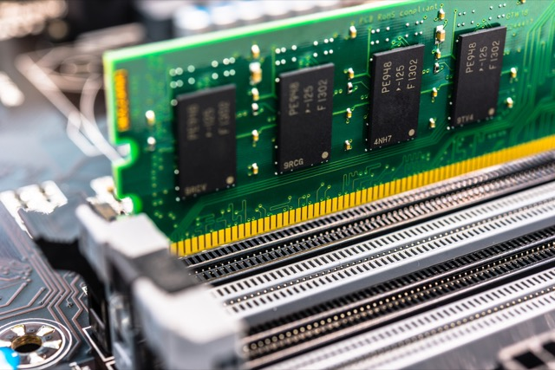
Processes and RAM
When OS starts a process needs to allocate a certain amount of memory on the RAM
RAM: Random Access Memory
You can think of the allocated RAM like an array, which process having reserved from index X to index Y
RAM:
x
y

Slide 19
Process Loading
OS will load the code (eg assembly-level, eg a “.exe” file on Windows) from the hard-drive to the RAM
Plus need to reserve extra space on RAM for the data (eg variables) manipulated by the process
When loading another process, OS makes sure to do not override the space of other processes
RAM:
Process 1
Process 2

Slide 20
Process Memory
low address
Code Segment: the actual code instructions
Data Segment: data like variables
Stack: for parameters and variables in function calls
Heap: for data that should “survive” between function calls
Note: we will go into the details in the “Algorithms and Data Structures” course…
system data segment (PCB)
…
...
…
…
8048314 <add>:
8048314: push %ebp
8048315: mov %esp,%ebp
8048317: mov 0xc(%ebp),%eax
804831a: add 0x8(%ebp),%eax
804831d: pop %ebp
804831e: ret
804831f <main>:
804831f: push %ebp
8048320: mov %esp,%ebp
8048322: sub $0x18,%esp
8048325: and $0xfffffff0,%esp
8048328: mov $0x0,%eax
804832d: sub %eax,%esp
804832f: movl $0x0,0xfffffffc(%ebp)
8048336: movl $0x2,0x4(%esp,1)
804833e: movl $0x4,(%esp,1)
8048345: call 8048314 <add>
804834a: mov %eax,0xfffffffc(%ebp)
804834d: leave
804834e: ret
804834f: nop
code segment
initialized variables
uninitialized variables
data segment
data segment
process A
heap
“unused” memory
stack
possible stacks
for more threads
high address

Slide 21
Continuous Index Space
As in an array, a process sees its allocated memory as continuous
If allocated memory from index 200 to 500, then all values from 200 and 500 are for the process, with no holes
WRONG:
Process 1
Still Process 1
CORRECT:
Process 1

Slide 22
Indices
An instruction could (at a very, very high level) be: “add 1 to variable at position 300”
The actual “300” would depend on where in the RAM the process is loaded
Be continuous, instructions will not alter memory allocated to other processes (easy check from min/max index)
Memory positions in code are virtual, and depend on the process location
In example below, virtual 300 would refer to 200+300=500 in RAM
RAM:
0
200
500
1000
4GB

Slide 23
Fragmentation
Assume a 8 GB RAM
You have 4 processes running, each one taking 2 GB
Then 2 processes are terminated (eg 2nd and 4th)
You need to start a 4 GB process
4 GB are free, but not continuous… what to do???
1 | 1 | 2 | 2 | 3 | 3 | 4 | 4
1 | 1 |  |  | 3 | 3

Slide 24
Virtual Indices
On RAM, do not need to have memory of process allocated in a continuous block (eg, from index 200 to 1000)
Memory can be fragmented, which is essential when you have several processes stopped/started at all times
Code instructions will refer to virtual indices that are continuous (ie no holes)
OS is responsible to provide mapping from virtual index to actual index on RAM
As RAM can be fragmented, mapping is more than just adding the starting position of process

Slide 25
Mapping (Simplified) Example
Virtual Index Space: 0-3
OS Memory Mapping:
0 -> 7
1 -> 1
2 -> 0
3 -> 4
2 | 1 |  |  | 3 |  |  | 0
0
1
2
3
4
5
6
7

Slide 26
Virtual Memory
A process works on a virtual memory
OS is responsible to map virtual indices to actual indices on RAM
Assume that you have 16 GB of RAM… what if you run processes that take more than 16 GB???
The memory of a running process can be stored on hard-drive
Page: continuous block of memory

Slide 27
Page Faults
1. Process requests virtual address not in memory,
causing a page fault.
2. Paging supervisor pages out
an old block of RAM memory.
“read 0110101”
“Page fault,
let me fix that.”
Process
Paging supervisor
old
Blocks in
RAM memory:
new
External disk
3. Paging supervisor locates requested block
on the disk and brings it into RAM memory.

Slide 28
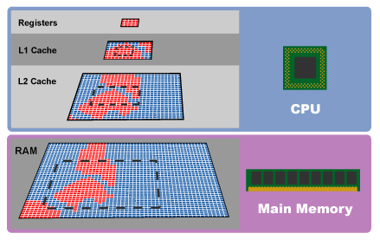
Caches
“Page Faults” is not only between RAM and hard-drive
Same concepts with L1-L2 caches
When CPU requires data not in registers, will recursively check caches and RAM

Slide 29
Memory Efficiency
Fast access memory is expensive
Caches: highly efficient, but small because expensive. Non-permanent
RAM: bigger/cheaper, but less efficient. Non-permanent
Hard-Driver: the largest, but also the slowest to access. Permanent, will keep data
OS Goals:
keep currently used data as close to CPU as possible (eg caches)
seldom used data (eg sleeping processes) can be in less efficient memory (RAM and hard-drive)
use heuristics to predict when data will be needed

Slide 30
Threads
A running process is composed of 1 or more threads
A thread of execution is a sequence of instructions that is scheduled by the OS
A thread executes the code of a process
OS decides on which CPU it should run, and when to suspend/resume it

Slide 31
Multi-Threading in Same Process
system data segment (PCB)
A process can have more than 1 thread running
Threads can execute exactly the same code in the process, or different sub-parts of the code (eg different functions)
Each thread can be run in parallel on different CPUs
Threads share the same “heap” in the memory of the process, but each one having their own function call “stack”
code segment
initialized variables
uninitialized variables
data segment
process A
heap
“unused” memory
stack
possible stacks
for more threads

Slide 32
Why not just 1 thread per process???
Eg, if I have 4 CPUs, and need to do a complex computation in parallel, why using 1process-4threads instead of 4p-1t?
Threads in same process shares the same virtual memory, so need less RAM
Eg, code needs to be loaded only once, instead of being present 4 times in 4 different process memory allocations
Threads can manipulate the same data in memory (eg, on “heap”)
Processes would need other more expensive mechanisms to share data, like writing/reading a file on hard-drive

Slide 33

Multitasking
You might have several processes/threads running on computer (in the 100s)
But limited number of CPUs (eg 1-4)
OS is responsible to schedule the threads, and allocate each of them some milliseconds to run on CPU, before suspend them and run some other threads
OS gives the illusion of running all of these threads at the same time

Slide 34
Stack-Based Buffer Overflow

Slide 35
Most Famous Type Of Vulnerability
Affecting code (typically web applications and IoT devices) written in languages like C, C++, Fortran, Assembly, where the process memory is directly manipulated
Even if you are not going to use such languages, it is still important to understand it, because it would explain the reasons why other safer languages do not allow you direct manipulation of the memory
eg, in Java, each array access is checked, and out of bounds accesses throw exceptions, which is not the case for example in C
However, safety comes with the price of less performance…

Slide 36
C code example
Can have code that reads data from user (eg in a web form)
To be manipulated, such data is stored in a buffer (eg an array of chars for string data)
What if the user data is bigger than the buffer???
In Java you would get an exception, but in C/C++…
#include <stdio.h>
int main(int argc, char* argv[]){
char buf[256];
strcpy(buf, argv[1]);
print(“%s\n”, buf);
}

Slide 37
Code | Heap | Stack
Low index,
eg starting at 0
High index
Executing Method foo(userInput) with a local char[5] buffer B
z
x
x+40
Code | Heap |  |  |  |  |  | * | Rest of Stack
B[0]
B[4]
The frame for foo() will contain 40 bits (assuming 8 bits per char) to hold array B of 5 chars. Plus, it will also have the index of next instruction * to execute once method foo() is completed, eg a value between 0 and z

Slide 38
Copying “Hello” into the buffer
‘H’ | ‘e’ | ‘l’ | ‘l’ | ‘o’ | * | Rest of Stack
Copying “Hello!” into the buffer, where B[5]==‘!’ will be outside the buffer length 5
‘H’ | ‘e’ | ‘l’ | ‘l’ | ‘o’ | ‘!’ | Rest of Stack
Whatever the return index of next instruction * was, now the computation will execute whatever it is at the location represented by the bit representation of the char ‘!’, likely crashing the program

Slide 39
Stack-Based Buffer Overflow
Buffer [] | Return Address | Rest of Stack
Padding | Corrupted Address | Malicious Code
User input, copied into the buffer, overflowing outside the buffer bounds
Eg, if buffer is size 10, send data more than 10 (eg 2000), where 11 is modified return code address, and from 12 on it is malicious code, and return address in 11 is the memory address where malicious code is located
When method call is finished, computation resume by executing the malicious code sent by the user as part of input data

Slide 40
File System

Slide 41
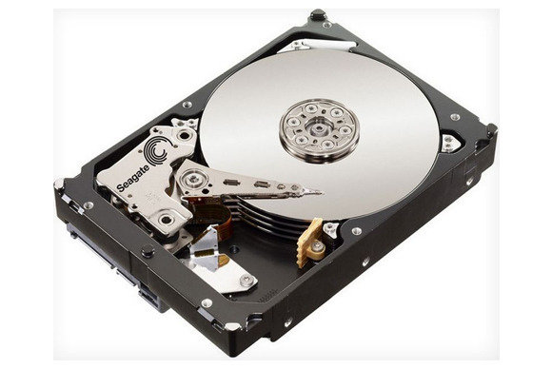
Files on Hard-Drive
system data segment (PCB)
Another important role of OS is to handle files on hard-drive
Details depends on OS
eg how to handle memory fragmentation when deleting/creating new files
When a process “reads” a file, the OS copies (parts of) its content in the RAM space of the process
code segment
initialized variables
uninitialized variables
data segment
process A
heap
“unused” memory
stack
possible stacks
for more threads

Slide 42
File Path
A file/folder can be identified by its path
A path is a hierarchical sequence of folders from the root till the file/folder
Windows: multiple roots, directly associated with a device, like “C:” (hard-drive) and “D:” (CD driver)
eg, “C:\Users\foo\someFolder\myfile.txt”
Unix-like (Linux/Mac/etc): one single root “/”. Different drivers (hard-drive, CD driver, USB-pens, etc) will be mounted and mapped as folders
eg, “/Users/foo/someFolder/myfile.txt”
Note the difference between path separators “\” (Windows) and “/” (Unix-like)

Slide 43
File Permissions
A computer can be used by different persons
You might want to prevent to read/modify files/folders of other users
Even if single user, you might want to prevent modifying OS files by mistake, unless you explicitly ask for it (eg, execute as “administrator”)
When accessing a file, OS checks if users has the right permissions

Slide 44
Base Permissions
read: able to read the content of a while, and check what is inside a folder
write: being able to modify (even delete) a file/folder
execute: for executable files, explicitly state if use can load and start it as a process
for example, you might have rights to read the content of a script file, but then cannot execute it

Slide 45
Owners and Groups
Each file is associated with an owner (eg, the user that created it) and a group (a set of users)
Permissions on a file (eg read/write/execute) are expressed for the owner, the group and the others (ie users that are neither the owner nor they are part of the group)

Slide 46
Permission Representation
Need to define read/write/execute (3 options) for owner/group/others (3 entities)
This can be done with a 9 bit number, 3-per entity, in order
1 means it has permission, 0 has not
Following can also be represented with “rwxr-x---” or “750” (111 is 7 in decimal, and 101 is 5)
Owner
Group
Others
1 | 1 | 1 | 1 | 0 | 1 | 0 | 0 | 0
read
write
execute
read
write
execute
read
write
execute

Slide 47
Virtual Machines

Slide 48
OS-specific Programs
Ever tried to run a PS4 game on Windows or an XBox?
Or a Windows application on a Mac?
Why do they NOT work?
Compiled code relies on system calls to interact with hardware (mouse, screen, etc), and those are OS dependent
system calls can be seen as APIs of the OS

Slide 49
Virtual Machines (VM)
Run a OS (guest) inside another one (host)
The guest OS runs in an emulated environment, controlled by a hypervisor / virtual machine monitor
The VM with guest OS runs likes a program in the host OS
The host OS can decide whether and how the guest OS interacts with the environment
The guest OS will be less efficient than host one, but performance is getting much better nowadays

Slide 50
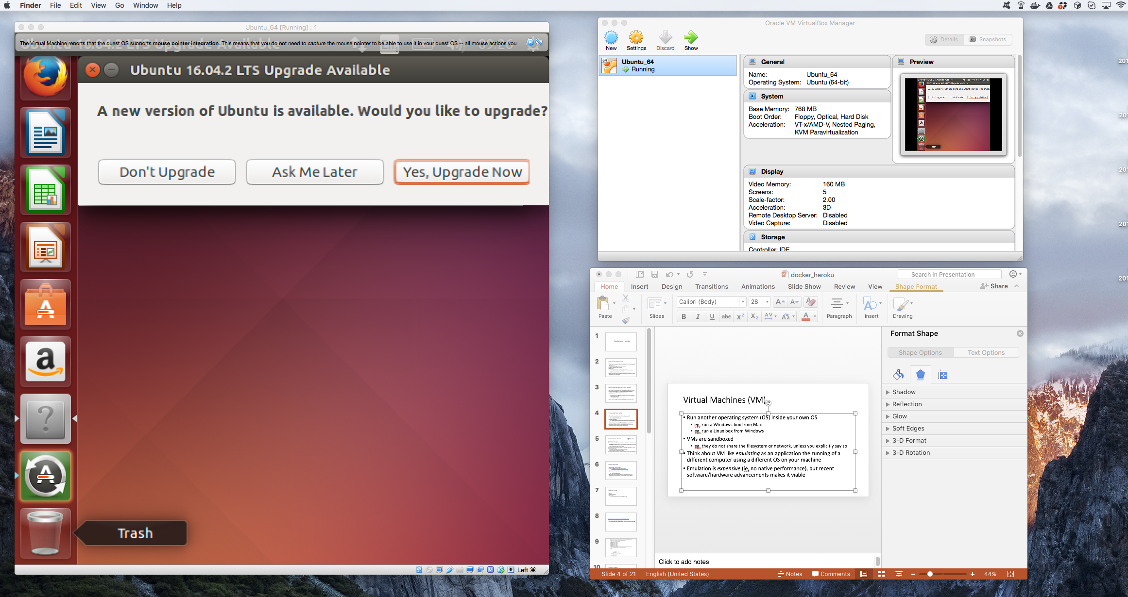
Linux running in Mac/Windows via VirtualBox

Slide 51
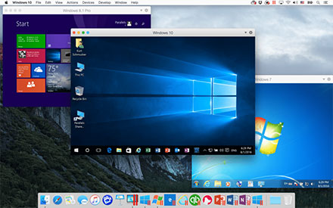
Windows running in Mac via Parallels

Slide 52
Why VMs?
Can run programs compiled/written for other OSs
Security: as host decides what guest can interact with, the guest is effectively run in a sandbox
Can also easily wipe out and re-run a comprised guest OS
Portability: instead of shipping a program which needs to be installed and configured (and that might only work for a specific OS), do ship an entire OS image including the program and everything it needs
such image will run in the VM

Slide 53
… before going on…
We are going to extensively use VMs in this course…
… but, as these VMs will be configured via scripts, we first need to learn a bit more about scripting…

Slide 54
Bash

Slide 55
Bash
Bash is a Linux/Mac/Unix shell and command language
There are also other kinds of shells
eg, PowerShell in Windows
A shell is also called: terminal, console, command-line, etc.
Enable to type commands (eg programs), and execute them

Slide 56
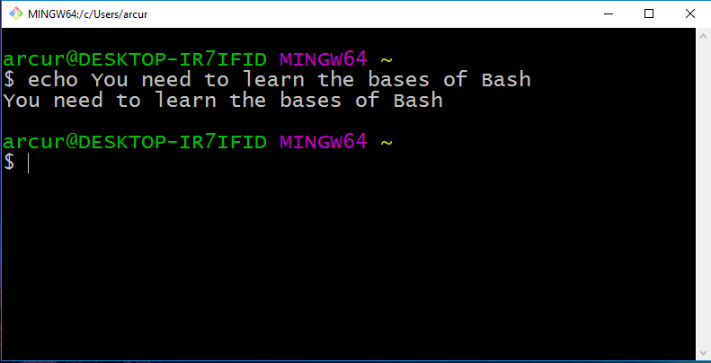

Slide 57
Why?
Critical skill when you are a programmer
Help automating several tasks
When dealing with web/enterprise systems, many servers will NOT have a GUI…
… you will access them remotely via SSH using a terminal
… this also applies for embedded and IoT devices
Helpful when commands with specific parameters (eg Git)
You need to be able to do basic commands

Slide 58
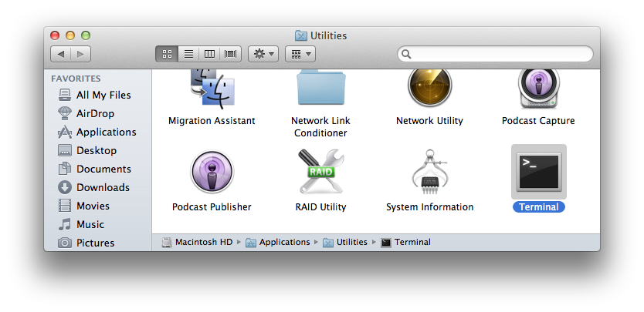
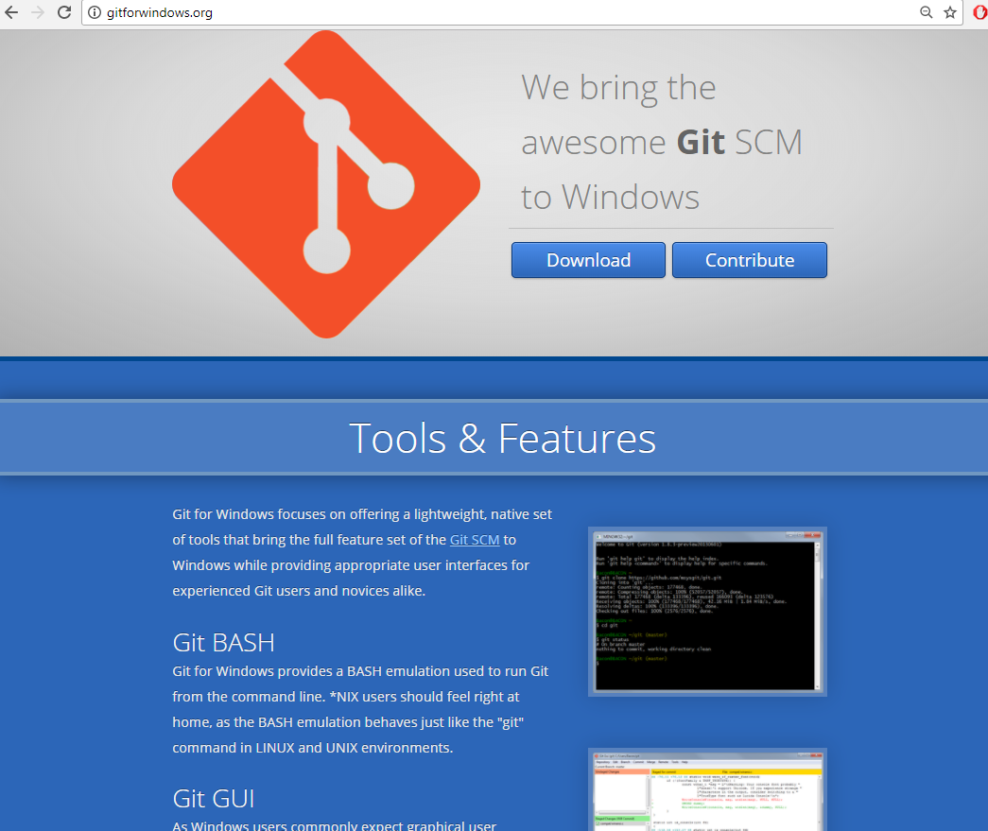
Installing Bash
If you are using Linux/Mac, it is already installed
Mac: Utilities -> Terminal
If using Windows, strongly recommended to install GitBash
which is part of “Git for Windows” at http://gitforwindows.org/

Slide 59
Basic Commands
“.” the current directory
“..” the parent directory
“~” home directory
“pwd” print working directory
“cd” change directory
“mkdir” make directory
“ls” list directory content
“cp” copy file
“mv” move file
“rm” remove (“-r” for recursive on directories)
“man” manual for a specific command

Slide 60
Cont.
“echo” print input text
“cat” print content of file
“less” scrollable print of file
“>” redirect to
“>>” append to
“|” pipe commands
“which” location of program
“$” resolve variables
“wc” word count
“find” files
“grep” extract based on regular expression
“touch” modify access time of file, and create it if non-existent

Slide 61
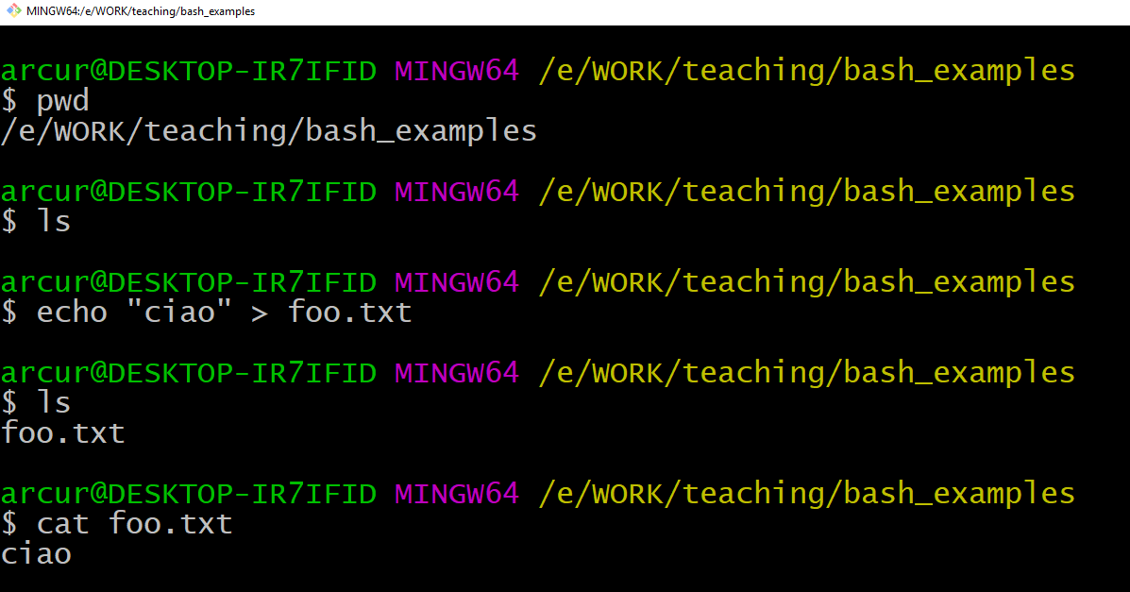

Slide 62
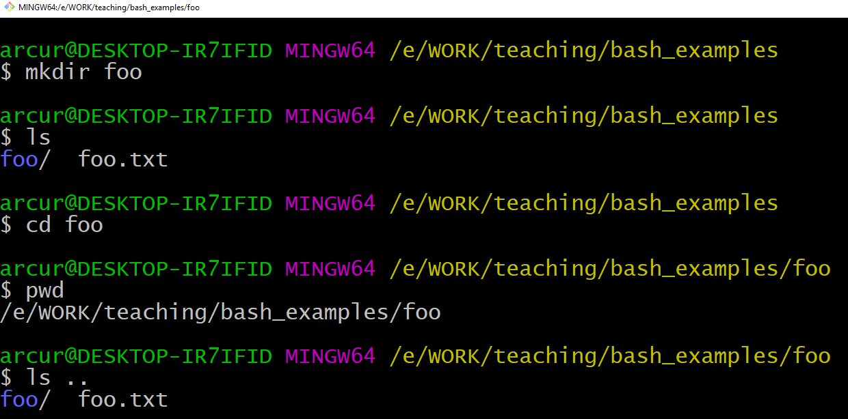

Slide 63
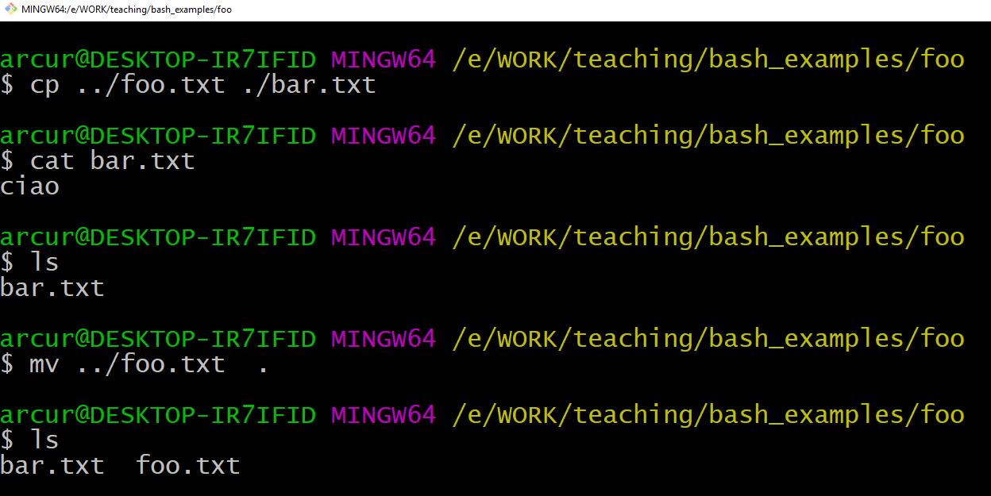

Slide 64
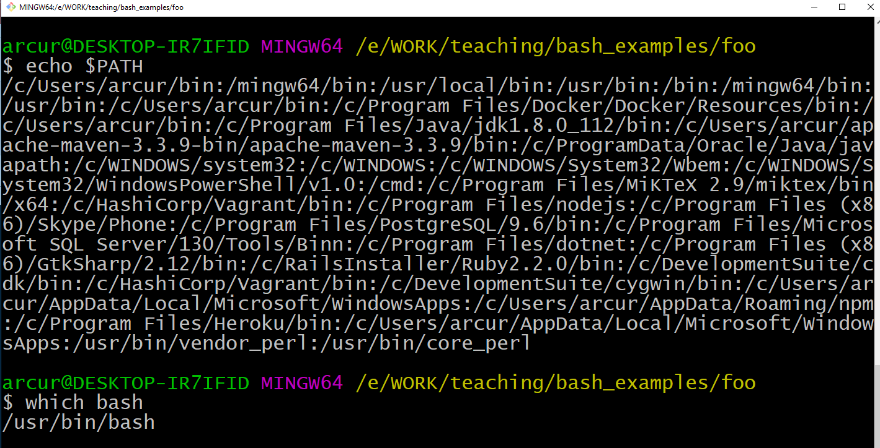

Slide 65
What if you want to count the number of lines of your programs?
Or the number of lines with a given word?
Eg “@Test” to count the number of tests in a program

Slide 66
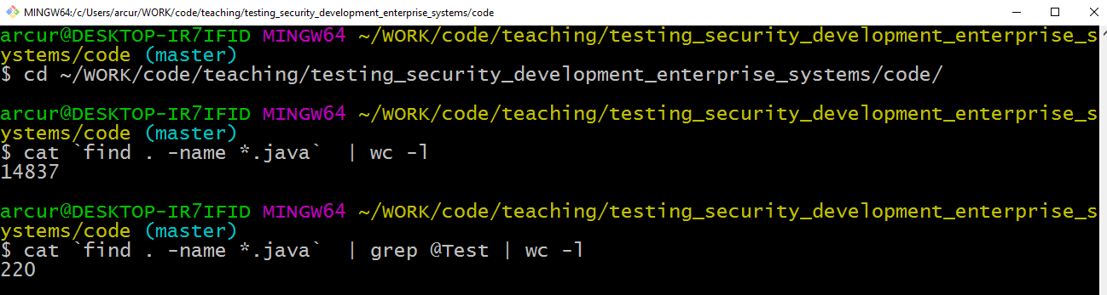
In this example, first recursively find in current directory “.” all the files that ends with “.java”
Then, such list of names is replaced inside ``, and so given as input to “cat”, which prints those files line by line
The output of cat is pipelined “|”, and given as input to grep
grep will output only the lines that contains the string “@Test”, ie it acts as a filter
the output of grep is then pipelined “|” to “wc –l”, which counts the number of lines in input
Therefore, that script checks content of all Java files and counts the number of lines in them having the text “@Test”

Slide 67
Useful Tips
User arrows (up/down) to go through history of commands
Use “tab” key to complete words, ie commands / file names
Bash commands can be put in executable scripts
Can use “*.sh” as file extension, eg “foo.sh”
First lines needs to be “#!<pathToBash>”, eg “#!/usr/bin/bash”
Then it can be executed from terminal like any other program

Slide 68
Docker

Slide 69
Deploy OS Images
When developing applications, not limit to just package your code
Java, NodeJS, PHP, etc.
Create a whole image of an OS, including all needed software
Eg the version of JRE/.Net/Ruby/etc. that you need
Particularly useful when developing web applications to install on a server
Do not install the OS image on the server, but rather run it in a virtual machine
Also, instead of installing a database, could just load a OS image with it
How to automate all this?

Slide 70

Docker to the Rescue
Automate the deployment of application inside software containers
Create whole OS images, based on predefined ones
Eg, a Linux distribution with the latest version of the frameworks you need
NodeJS, PHP, JDK, etc.
Large online catalog of existing base images at Docker Hub
Your application, and any needed third-party library, will be part of the OS image
Use Docker (and tools built on / using it) to deploy your OS images and start them locally or on remote servers

Slide 71
How to Use Docker?
First you need to install it
https://store.docker.com/
Note: if you are using Windows, Home Edition might not be enough. You would need a better version, like the Educational one, which you should be able to freely get from school
To run existing images, you just need to type commands from a shell terminal (eg, GitBash)
When you are writing your own projects, you need to create configuration files
Dockerfile: specify how to build an OS image
docker-compose.yml: for handling multi-images
Then, use docker and docker-compose commands from the command line

Slide 72
Docker Examples
https://docs.docker.com/get-started/
https://hub.docker.com/r/docker/whalesay/
docker run docker/whalesay cowsay boo
This will install the image “docker/whalesay”, and run it with input “cowsay boo”
First time you run it, the “docker/whalesay” image will be downloaded

Slide 73
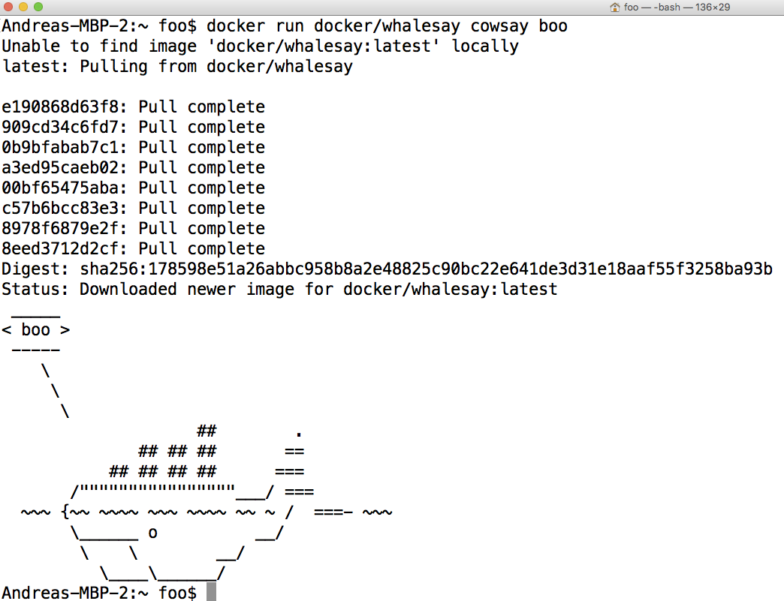

Slide 74
Custom Images
Extend existing images to run the applications you develop
Just need to create a text file called “Dockerfile”
3 “main” parts (there are more…)
FROM: specify the base OS image
RUN: execute commands in the virtual OS to set it up, like installing programs or create files/directories
CMD: the actual command for your application
# are comments
docker build -t <name> .
Create an image with name <name>, from the Dockerfile in the current “.” folder
docker run <name>
Run the give image
docker ps
Show running images
docker stop <id>
Stop the given running image. Note: an image can be run in several instances, with different ids

Slide 75
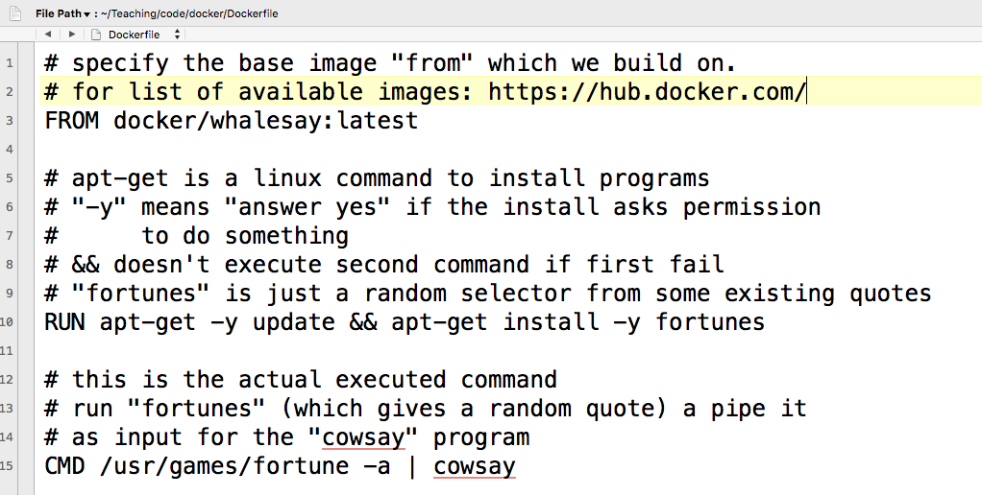

Slide 76
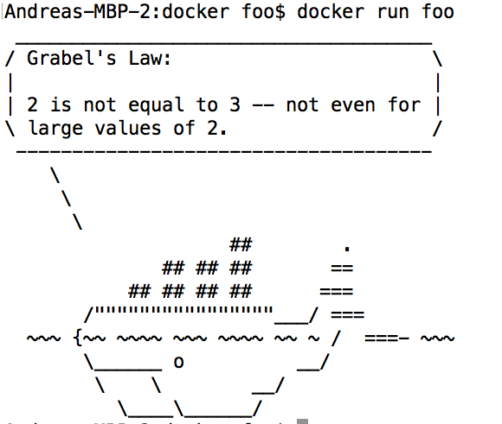

Slide 77
Some Further Commands
ENV: define an environment variable
COPY: take a file X from your hard-disk, and copy it over to the Docker image at the given path Y
When Docker image runs, it can access X at path Y, even when you deploy the image on a remote server
WORKDIR: specify the working directory for the executed commands
Think about it like doing “cd” to that folder, so all commands/files are relative to that folder, and you do not need to specify full path

Slide 78
Networking
When you run a server on your local host, it will open a TCP port, typically 80 or 8080
A server running inside Docker will open the same kind of ports, but those will not be visible from the host OS
You need to explicitly make a mapping from host to guest ports
Ex.: docker run –p 80:8080 foo
When we do a connection on localhost on port 80, it will be redirected to 8080 inside Docker

Slide 79
CTRL-C
When running Docker (eg “docker run”) in a terminal, you can use CTRL-C to stop it
On Windows/GitBash it might happen that the image still run in background
Use “docker ps” to check if indeed the case
Use “docker stop <id>” to stop an image manually
If you have Docker images running in the background, that can be a problem if they use TCP ports

Slide 80
For Next Week
Book pages: 114-129, 152-153
Note: when I tell you to study some specific pages in the book, it would be good if you also read the other pages in the same chapter at least once
Note: Bash and Docker are not in the book
Exercises for Lesson 3 on GitHub repository

